Slide 1
Virtual Interactive Classroom
Team Members:
Ahesanali S. Suthar 06CP220
Sanjay Y. Rajwadi 06CP233
Pratik Macwan 07CP294
Monitoring Faculty:
Mr. Darshak G. Thakor

Slide 2
Introduction
This project VIRTUAL INTERACTIVE CLASSROOM is aimed to develop to handheld software for an administrator and also for a teaching faculty to look after, to manage and to control all the users accessing the network.
This project is a generalized project that can be used in any organization to handle a large network or in any computer lab to interact with different students as a teaching faculty.

Slide 3
In case, if administrator wants to monitor what the user is doing then he can connect to the user machine in a view mode and he/she can track what a particular user is doing at a current time and also he/she can inform that particular user by message.
In case, if an administrator wants to have a file from remote pc or to send a file to remote pc he/she can simply do it by connecting with user in FILE DOWNLOADING mode or FILE TRANSFER mode.
Also, students (users) and teaching faculty (admin) can interact with each other using chatting facility provided in the project and also make interaction with individuals.

Slide 4
Tools to be used
Netbeans IDE 6.5M1
JAVA Development kit JDK 1.6
OS Environment: Windows XP

Slide 5
Main Objective
One of the main objective of this project to develop handheld software for an administrator to look after, manage and to control all the users access in the network.
The other objective of this project is that, in any organization students (users) can connect with teaching faculty (admin)
so that teaching faculty can interact with connected students with different facilities provided in the project to solve their problems related to study and also give presentation on related subjects.

Slide 6
Also different connected students (users) can interact with each other
They can share their doubts related to any subject and also can interact with the teaching faculty to clear their doubts.
This project basically used where numbers of machines are connected to each other through network or in any Educational organization where different users like students and faculty are connected.

Slide 7
Main Module
File Transfer/Downloading:
This module provides file transferring and files downloading facility to administrator.
Administrator can transfer file from server machine to client machine or download the file from client machine to server machine by selecting required IP address of the client, the source path and the destination path.
Message Broadcast:
This module provides message sending facility to administrator to the connected any particular client or all the connected clients.

Slide 8
Chatting:
This module provides chatting facility to the all clients and server to interact with each other by logging into chat room by entering the server IP address and their names.
Access Control:
This module provides facility like shutdown, restart and logoff of the client machine. Only administrator can perform this task.

Slide 9
Remote View Mode:
This module provides screen capturing facility to the administrator to watch out any particular client machine’s screen.
Session View:
This module provides server screen view to the connected clients by the server permission. Server can start the session and stop the session.

Slide 10
Implementation
Basically this project is divided in two parts.
Administration (Server)
Remote Agent (Client)
We have five modules and we have implemented interfaces for each module.
These interfaces are implemented by their relative classes. And relative module uses their relative class.

Slide 11
So the Remote Agent (Client) registers the object for each module.
So Administrator (Sever) can use that for remote method invocation on that machine by looking up for the object by registered name and invoke the methods that are implemented by relative class.
Same way when Remote Agent wants services from Administrator, object for that is registered by Administrator (server). And Client is looking for that object by registered name and invokes the methods.

Slide 12
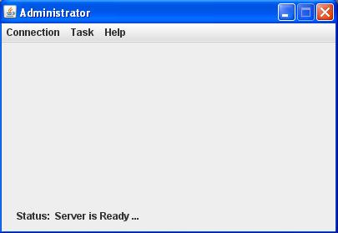
Administrator Screen

Slide 13
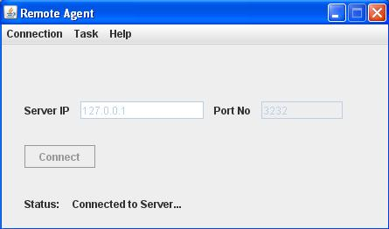
Client Screen

Slide 14
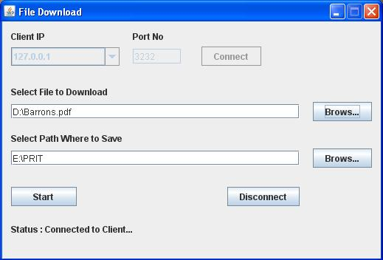
File Transfer Form

Slide 15
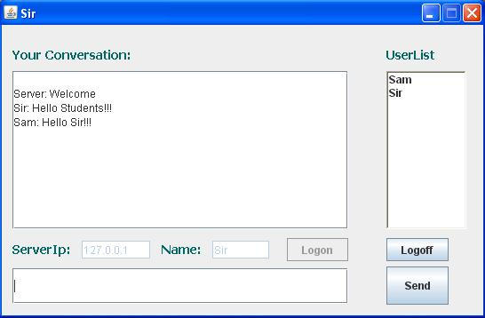
Chatting

Slide 16
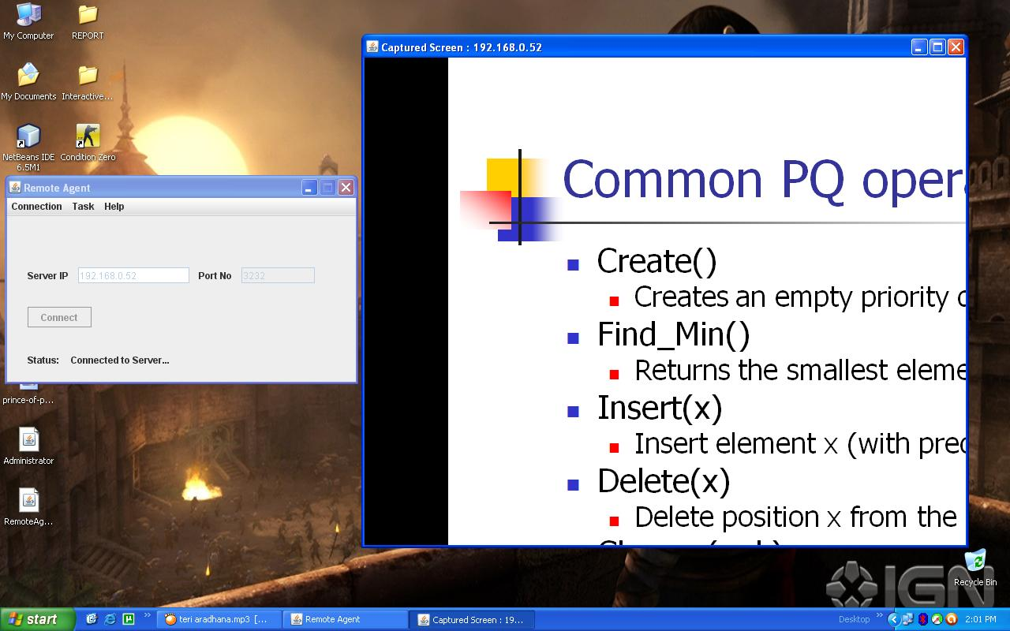
Server Screen On Client Screen

Slide 17
Conclusion
File transfer and downloading module we have successfully downloaded the file from the clients to the server and successfully transferred the file from server to the clients.
Message broadcasting is also successfully worked form server and client can also send the message to server through message to server facility.
Server can shutdown, restart and logoff the desired client machine. This module is specifically worked in windows OS environment.
Server can see the client screen at current time easily and different clients can see server screen if server allows.
So now all the students can easily see the presentation taken by the teaching faculty on their on machine.

Slide 18
Future Enhancement
Fast response time on low latency networks including slow dial up connections.
Full-featured secure file transfer lets you access files on the remote computer and securely transfer them between local and remote computers in any direction.
Clipboard transfer automatically or manually synchronizes the clipboards of the remote and local computers making it easy to copy and paste text between two machines.
Remote PC shortcuts let you create file-based shortcuts to remote computers. Double clicking a shortcut takes you directly to the remote computer.

Slide 19
Resolution change option lets you view the entire screen of the remote computer
Command-line interface lets you automate such tasks as installing the software, controlling the server, or running the client.
Server icon in the system's tray provides single click access to the server window and all of its settings.
Video streaming of remote & voice transferring machine screen can be implemented.

Slide 20
References
Books:
Herbert Schildt, “The Complete Reference JAVA2”, 5th Edition, Tata McGraw-Hill.
Troy Bryan, “Remote Method Invocation JAVA”, 2nd Edition
Websites:
www.java.sun.com
www.google.com
www.hpjava.org

Slide 21


